Slide 1
Conditional Statements

Slide 2
Conditional Statements/Decision making statements
In JavaScript, there are three forms of the if...else statement.
1 if statement
2 if...else statement
if...else if...else statement
Nested if

Slide 3
1 if Statement
The syntax of the if statement is
if (condition) {
// the body of if
}
Eg: check if the number is positive.
The if statement evaluates the condition inside the parenthesis ().
If the condition is evaluated to true, the code inside the body of if is executed.
If the condition is evaluated to false, the code inside the body of if is skipped.

Slide 4
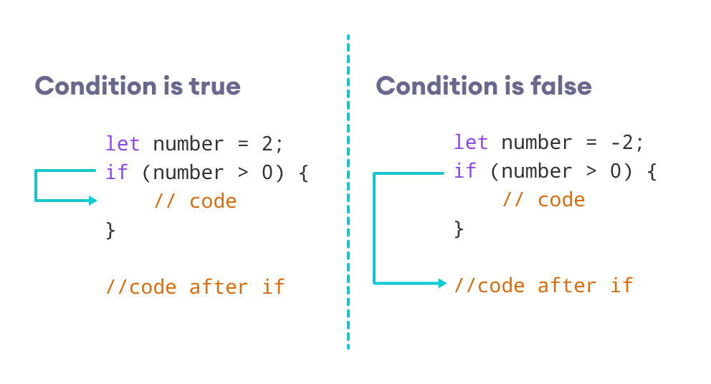

Slide 5
2 if...else statement
An if statement can have an optional else clause. The syntax of the if...else statement is:
if (condition) {
// block of code if condition is true
} else {
// block of code if condition is false
}
Eg: program to check if the number is even or odd
The if..else statement evaluates the condition inside the parenthesis. If the condition is evaluated to true,
The code inside the body of if is executed
The code inside the body of else is skipped from execution
If the condition is evaluated to false,
the code inside the body of else is executed
the code inside the body of if is skipped from execution

Slide 6
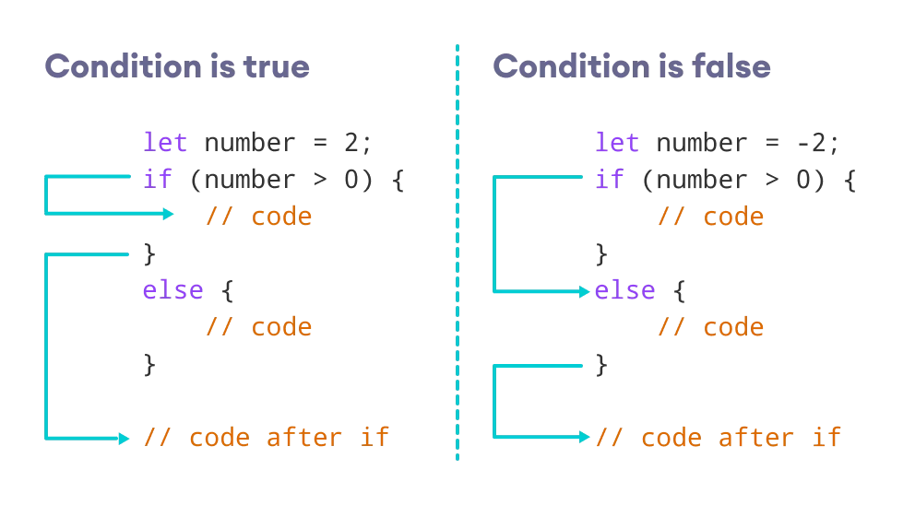

Slide 7
3 if...else if statement
The if...else statement is used to execute a block of code among two alternatives. However, if you need to make a choice between more than two alternatives, if...else if...else can be used.
if (condition1) {
// code block 1
} else if (condition2){
// code block 2
} else {
// code block 3
}
• If condition1 evaluates to true, the code block 1 is executed.
• If condition1 evaluates to false, then condition2 is evaluated or If the condition2 is true, the code block 2 is executed.
• If the condition2 is false, the code block 3 is executed.

Slide 8
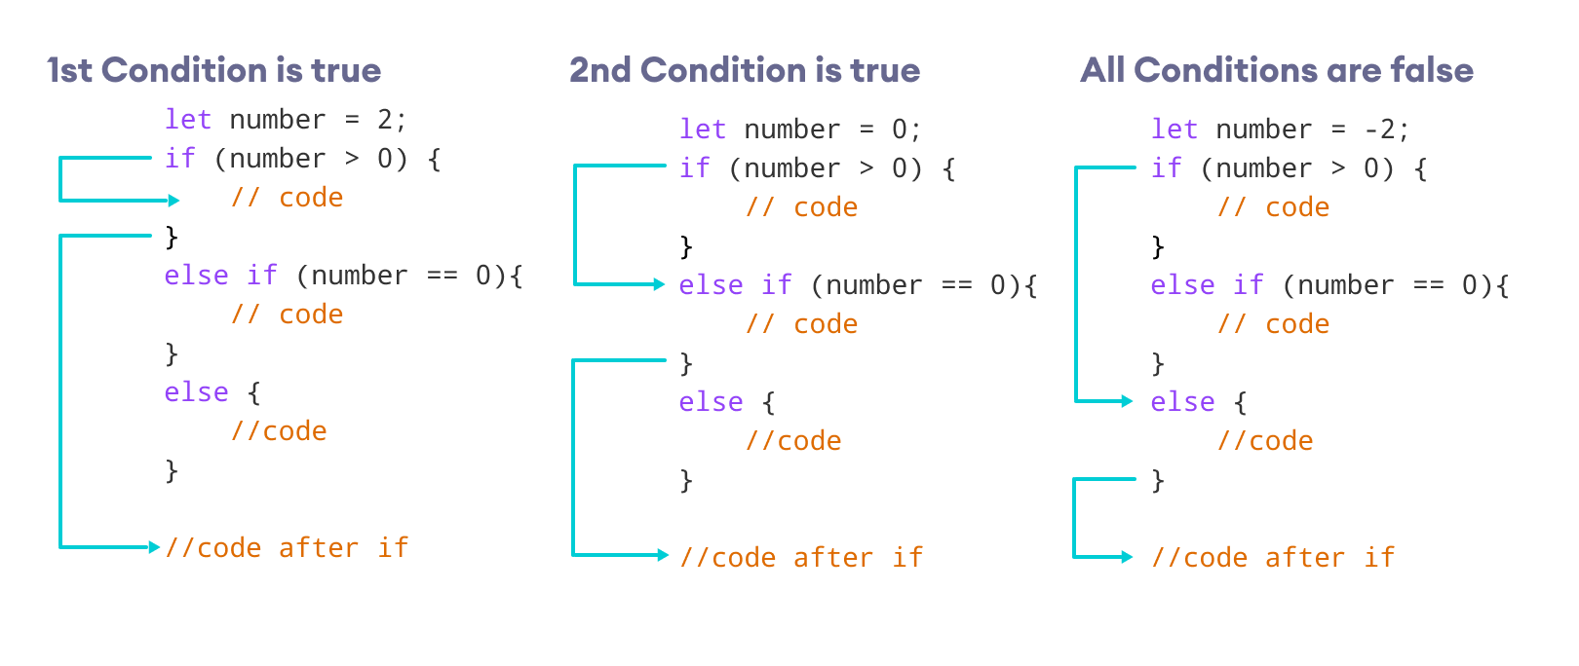

Slide 9
4 Nested if...else Statement
if...else statement inside of an if...else statement. This is known as nested if...else statement.
if (condition1) {
if (condition2){
}
else {
}
}
else{
}

Slide 10
Tasks
1. Use logical operators to find whether the age of a person lies between 10 and 20?
2 .Demonstrate the use of switch case statements in js
3 .Find whether a number is divisible by 2 and 3
4 .Find whether a number is divisible by either 2 or 3
5 .Print "You can Drive" or "You can't Drive" based on age being greater than 18 using ternary operator

Slide 11
Thank you

